Slide 1

F1- Lap time insights
BY ALI JAAFAR

Slide 2

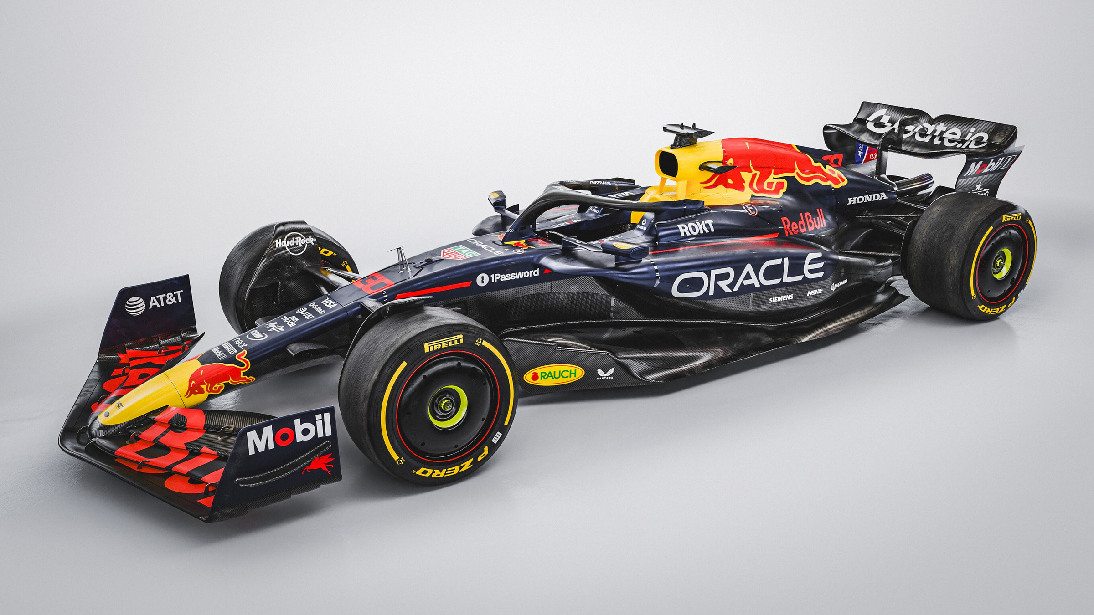
Problem Statement
Race results alone often fail to explain the dynamics that shape a Grand Prix. While lap time data captures the pace and performance of every driver across a race, it is rarely analyzed in depth to uncover why outcomes unfold the way they do. Without this deeper view, race control operators, officials, analysts lack critical insight into the patterns of driver performance, the impact of weather, and the relationship between starting and finishing positions.
and most importantly is what is the main thing that make one driver is champion over a nother

Slide 3

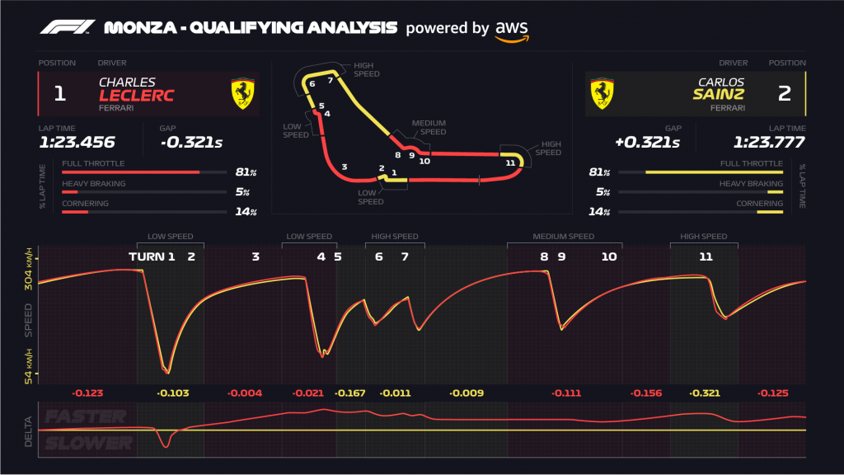
What I Aim to Achieve
This project uses detailed lap time analysis to go beyond final results and reveal the hidden performance stories.

Slide 4
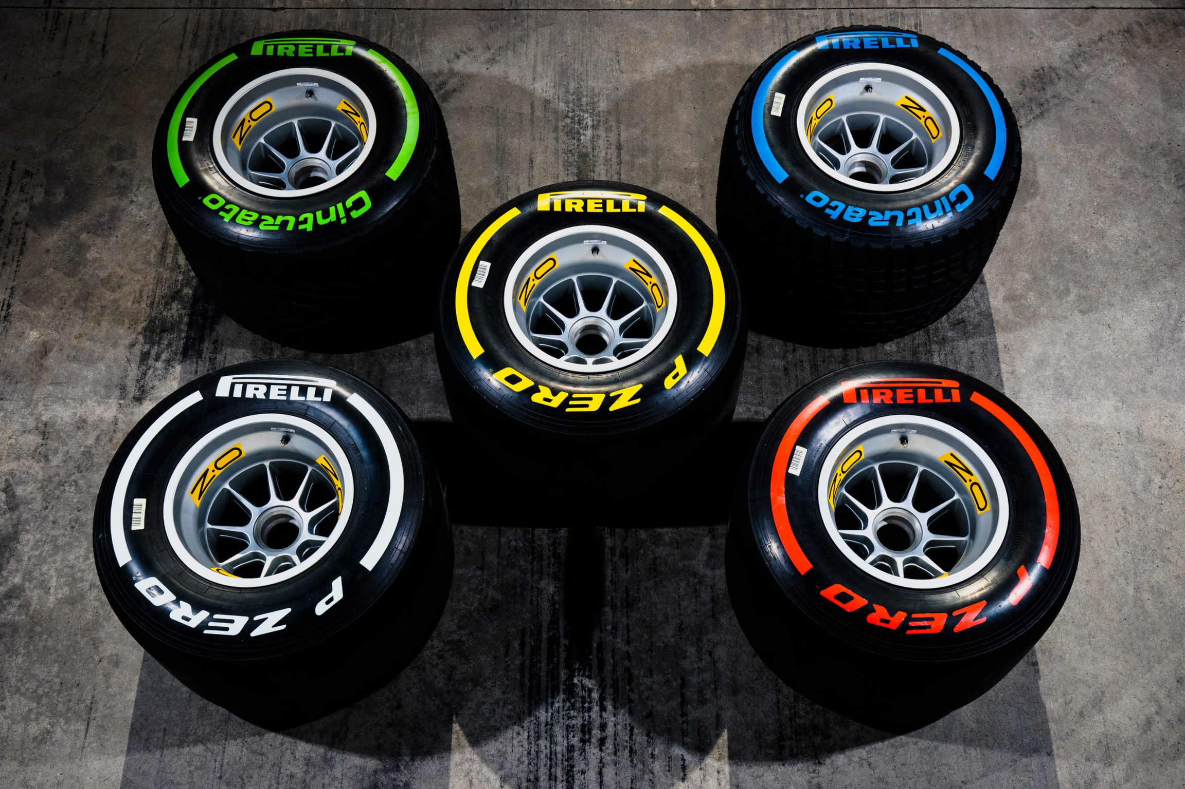
About the Dataset
The Data Covers 2019–2021 Seasons F1 lap times
10 Team in 3 seasons
20 Drivers in 3 seasons
more than 60k Laps
5 Tyre Compounds
mixed Weather conditions
All Stints And Tires Changing

Slide 5


Who is This For?
Race Stewards & Sporting Officials (FIA)
race control operators
Motorsport Analysts
Fans

Slide 6

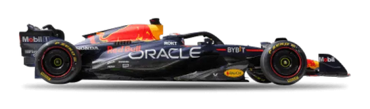
what is formula one ?
Formula One is the highest level of international car racing, where drivers compete in specially built single-seater, open-wheel cars. Races are called Grands Prix, held on circuits and streets around the world.
The highest level of car racing in the world
Cars can go 300+ km/h
Each race = Grand Prix (GP)
A season has 20–24 races around the world

Slide 7
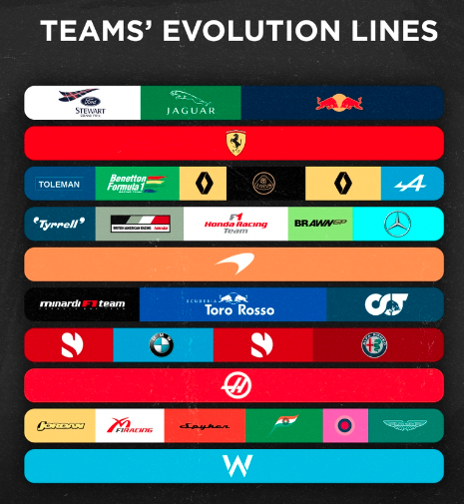











Constructors
In Formula One, a constructor is the team that designs and builds the car.
Each constructor enters two cars (and therefore two drivers) in every race.
Constructors fight for the Constructors’ Championship
Points from both drivers are added together to decide which constructor ranks higher.

Slide 8
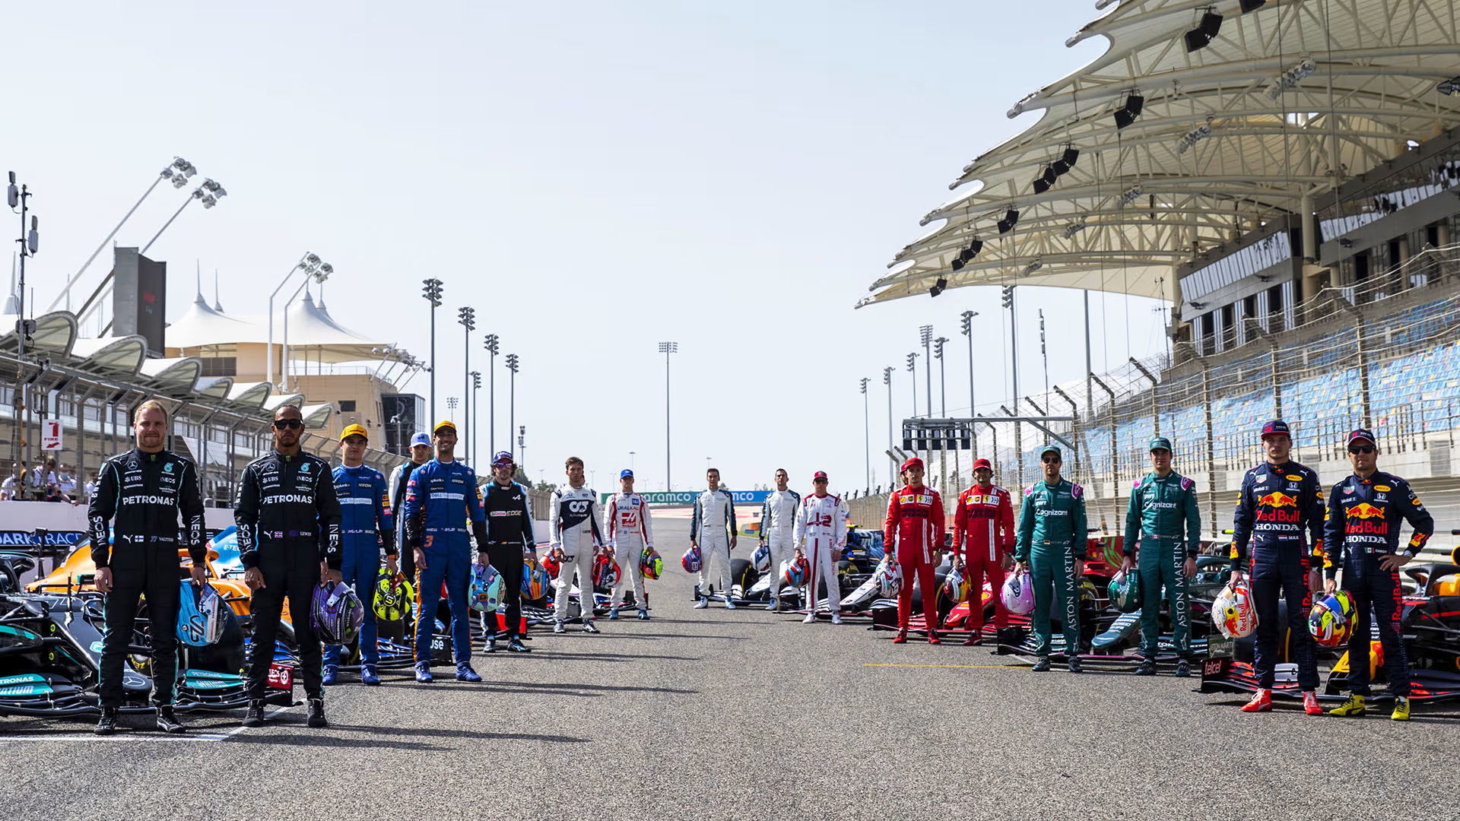
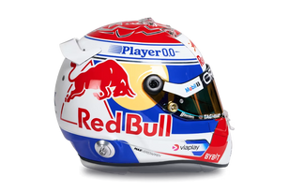
Drivers
Drivers are the athletes who race the cars. Each constructor has two drivers, competing both for themselves (in the Drivers’ Championship) and for their team (in the Constructors’ Championship).
Drivers earn points based on finishing positions in each race.
The one with the most points at the end of the season becomes World Champion.
1st place → 25 points
2nd place → 18 points
3rd place → 15 points
4th place → 12 points
5th place → 10 points
6th place → 8 points

Slide 9





Tires
Soft = fastest, wears quickly
Intermediate = light rain
Medium = balanced
Wet = heavy rain
Hard = durable, slower
🔄 stint
Soft → pit → Medium
|------||------|
🔄
stint 1
stint 2

Slide 10
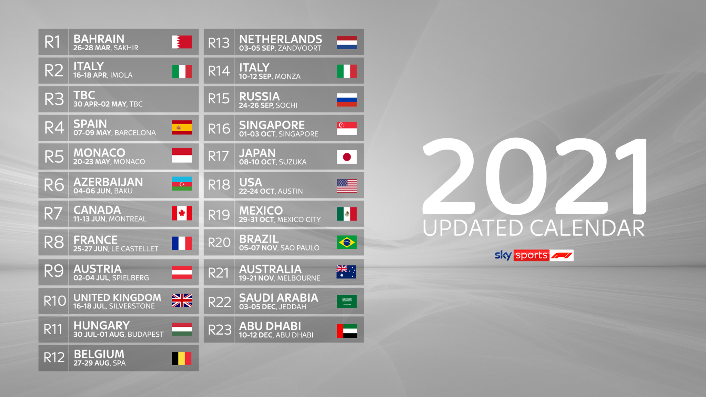
When & Where They Race?
Season: March → December
Tracks all over the world:
🇲🇨 Monaco (street race)
🇮🇹 Monza (very fast)
🇧🇭 Bahrain (night desert race)
🇦🇪 Abu Dhabi (season finale)

Slide 11
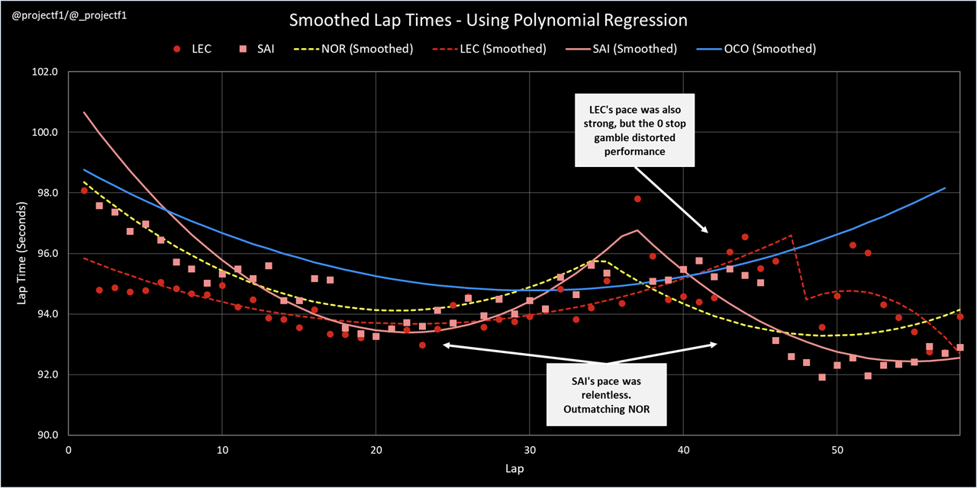
Diving Into The Data

Slide 12
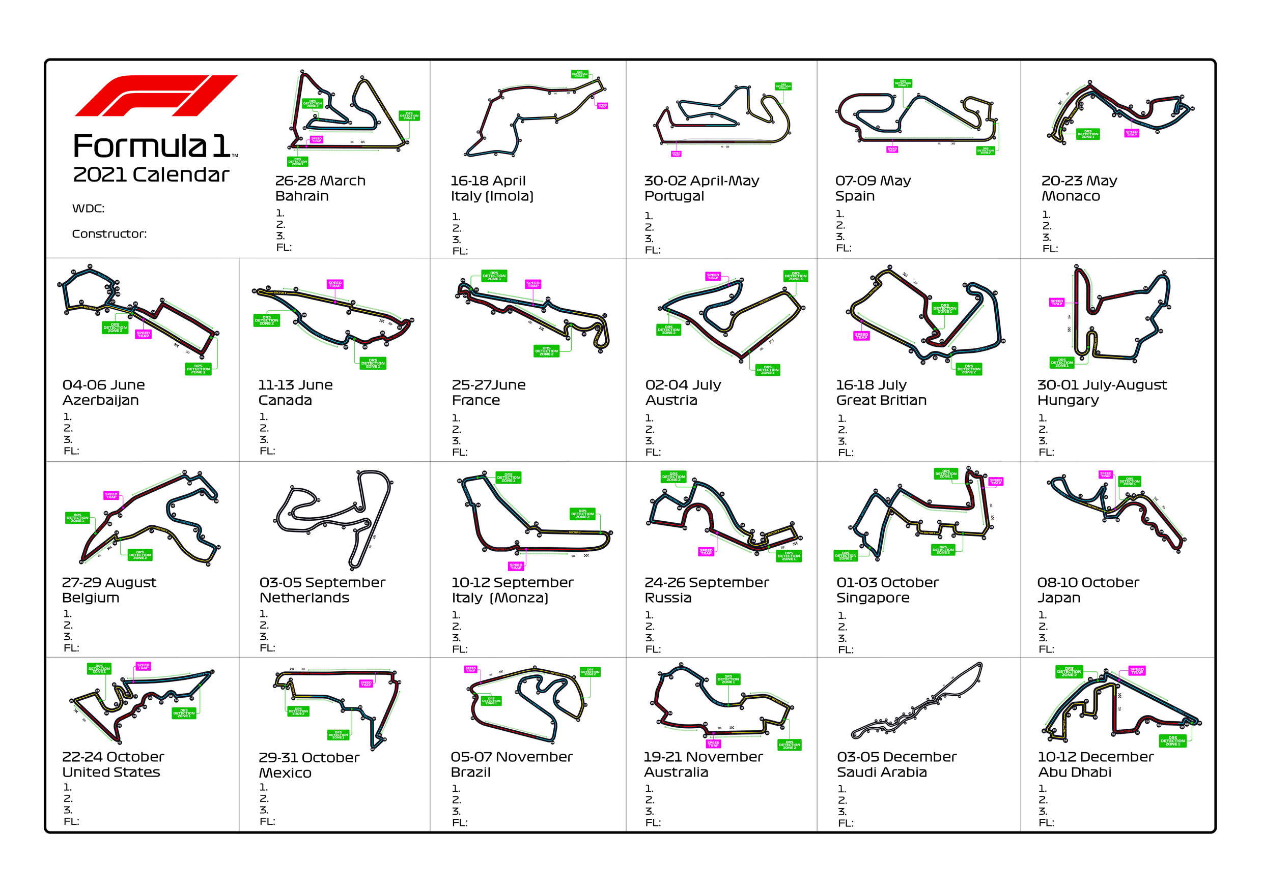
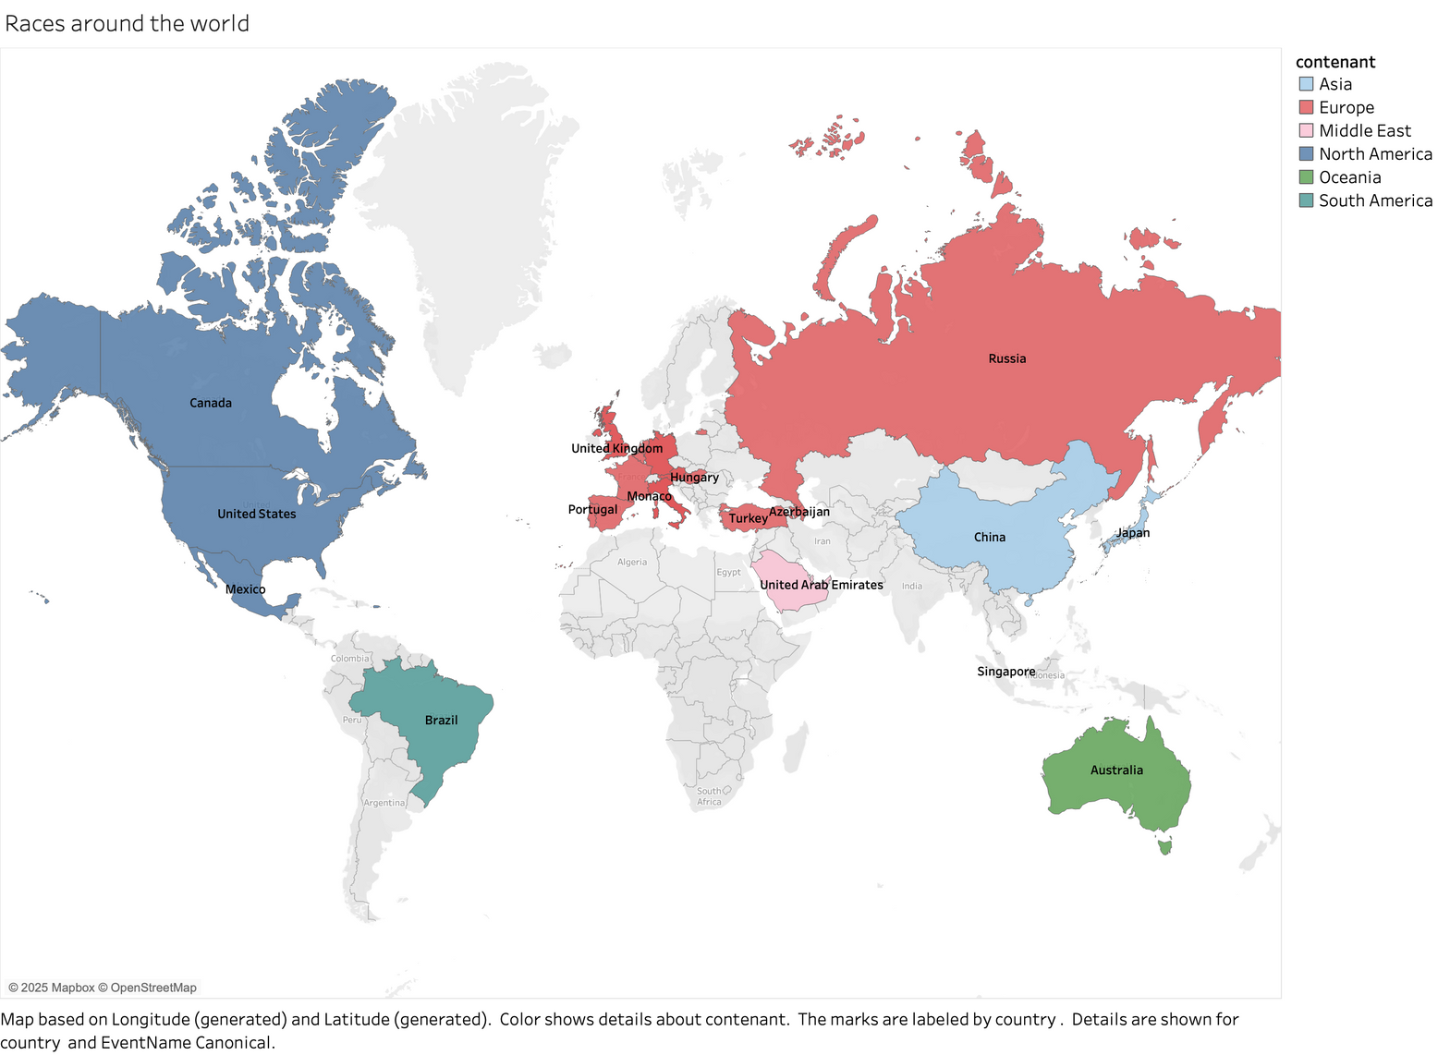
Races Around The World

Slide 13
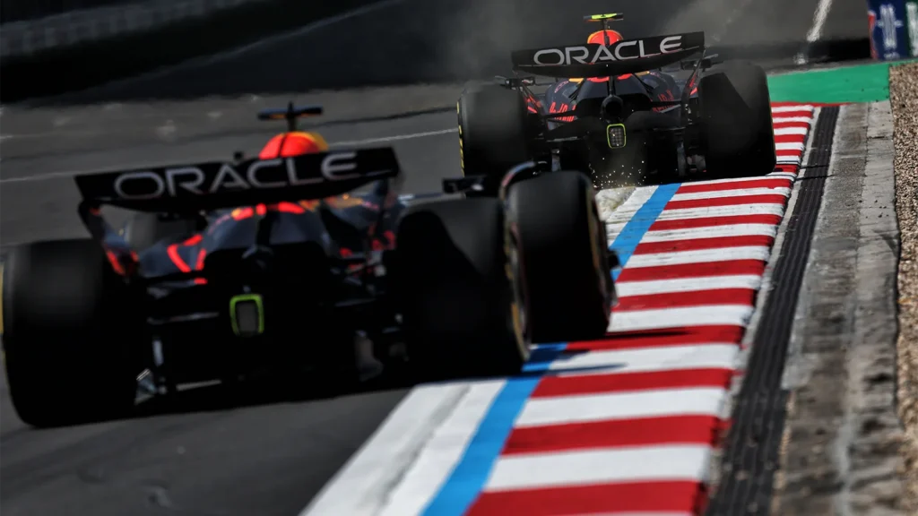
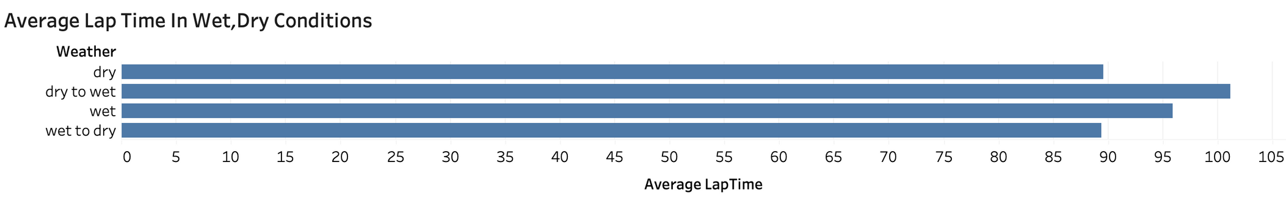
Weather Conditions

Slide 14
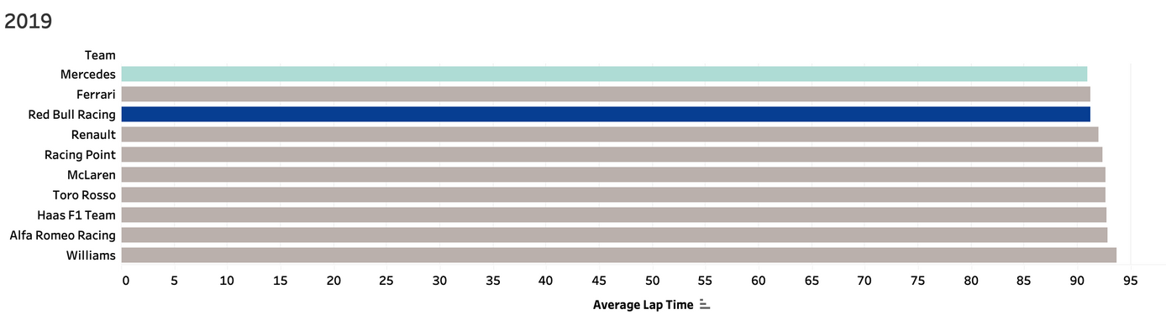
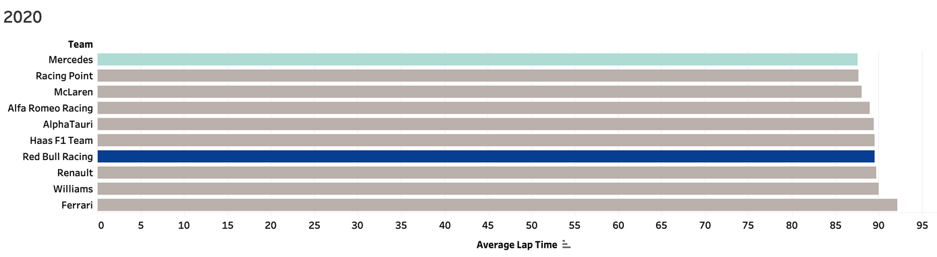
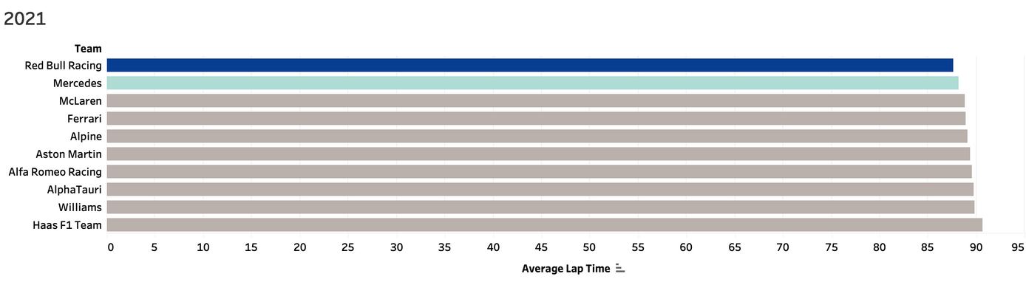
Teams Performance
Teams are competing every season to get the constructors championship

Slide 15
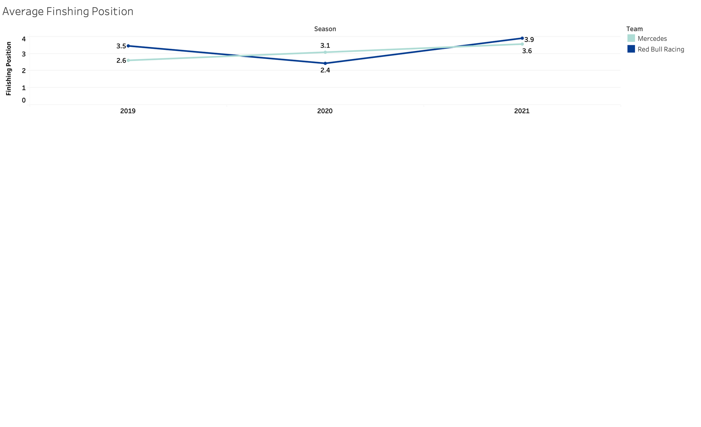
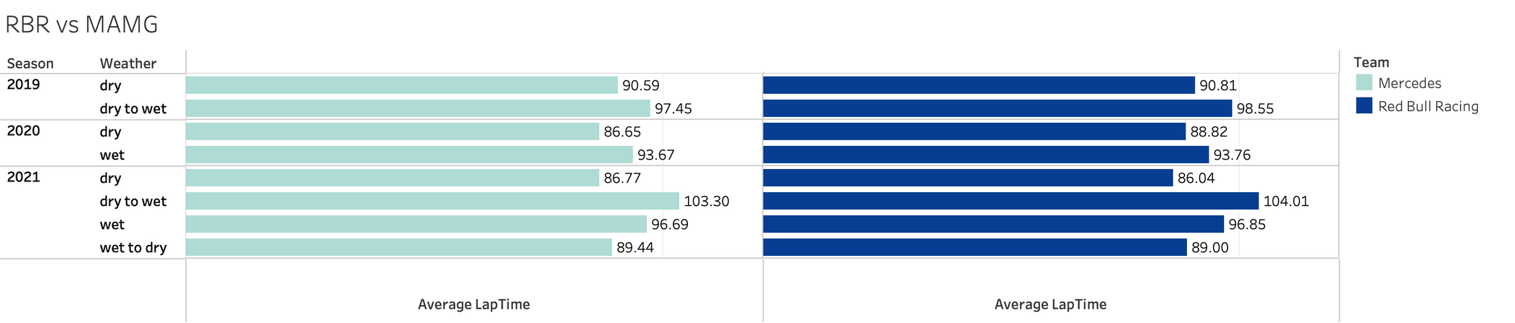
RedBull VS Mercedes

Slide 16
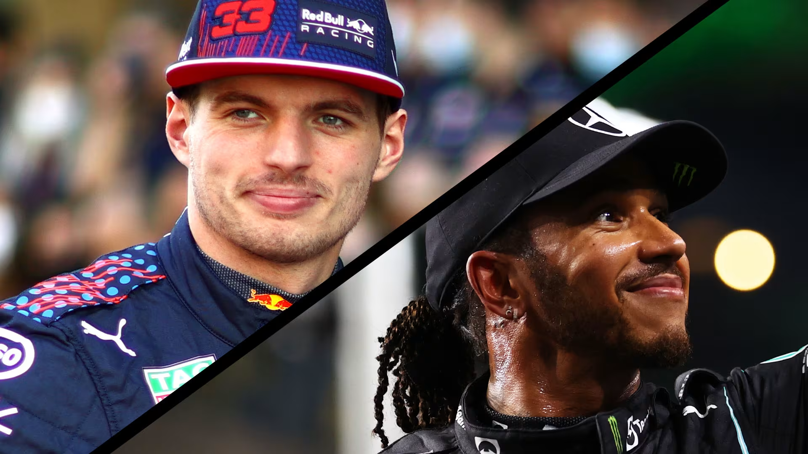
Focusing On The Two Main Rivels

Slide 17
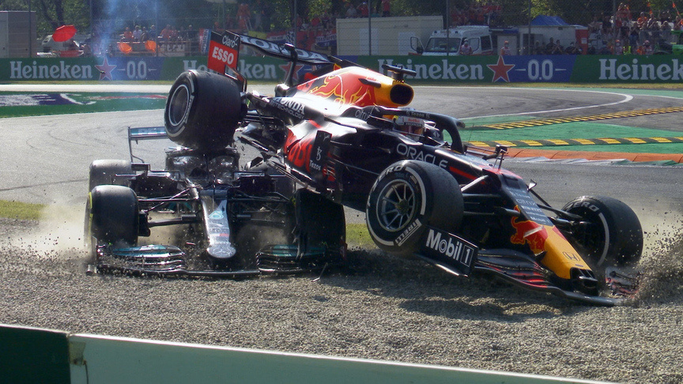
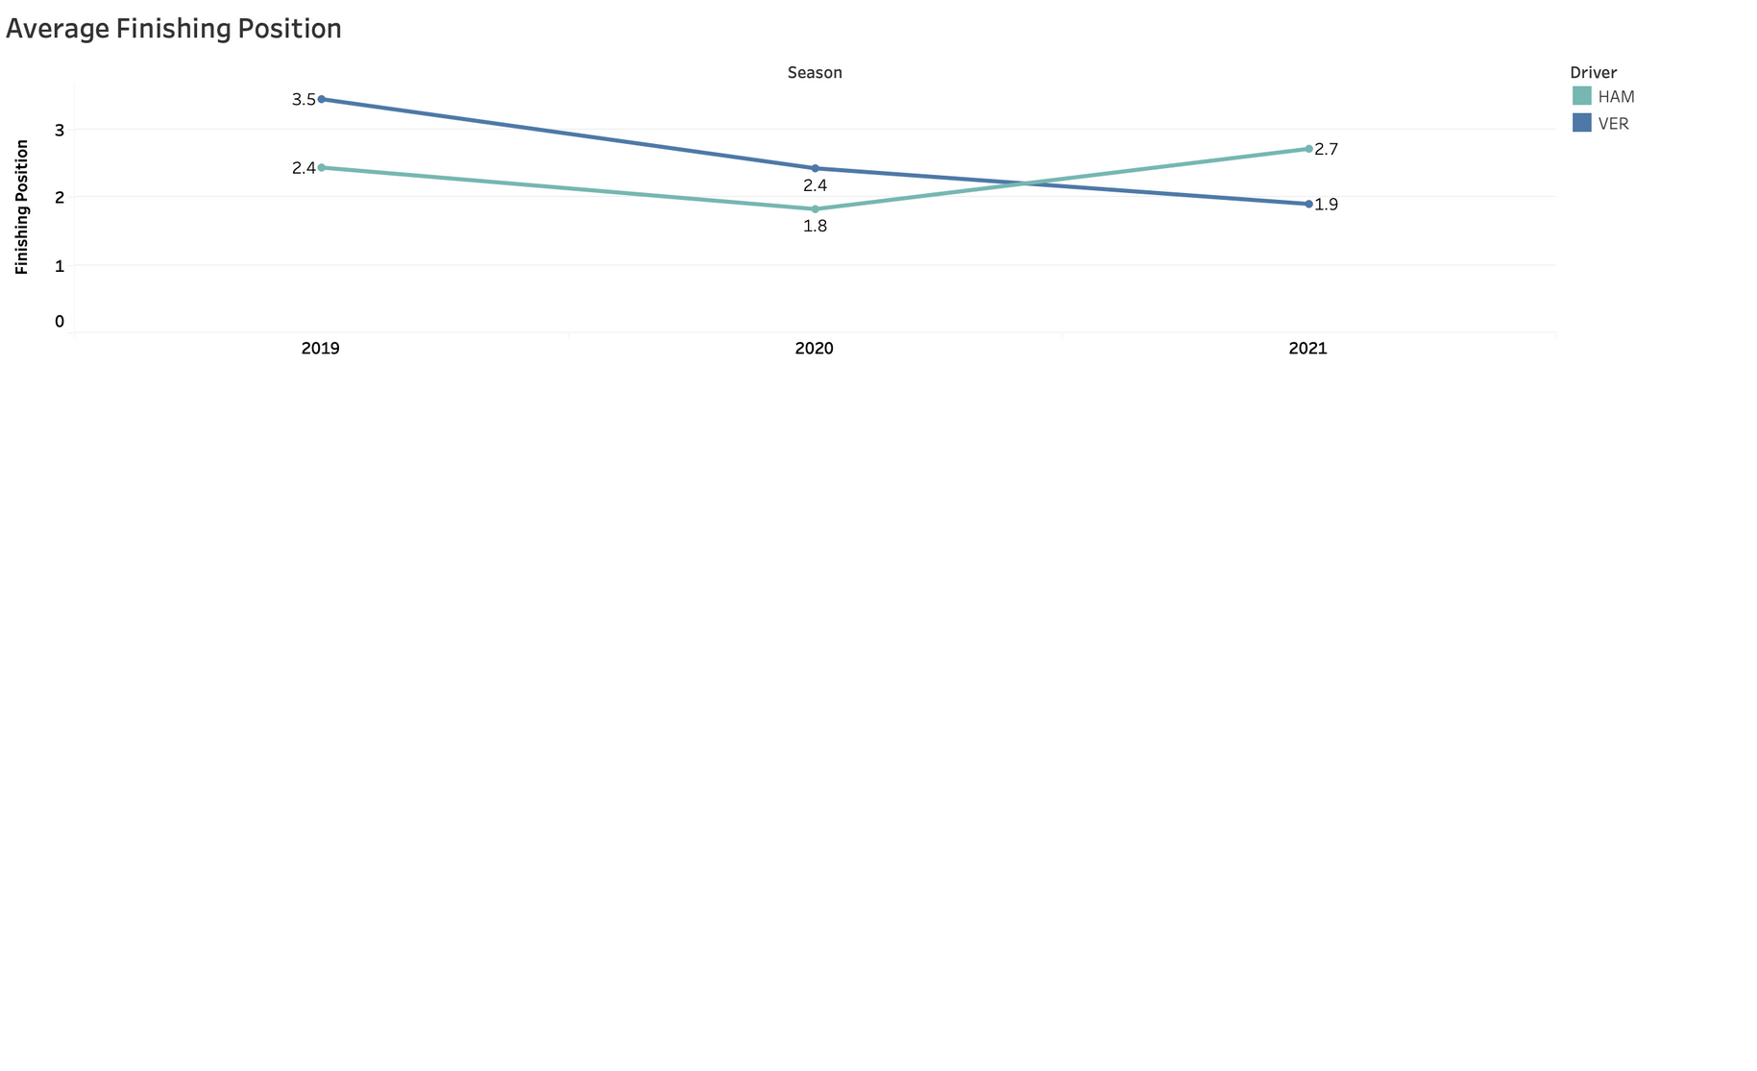
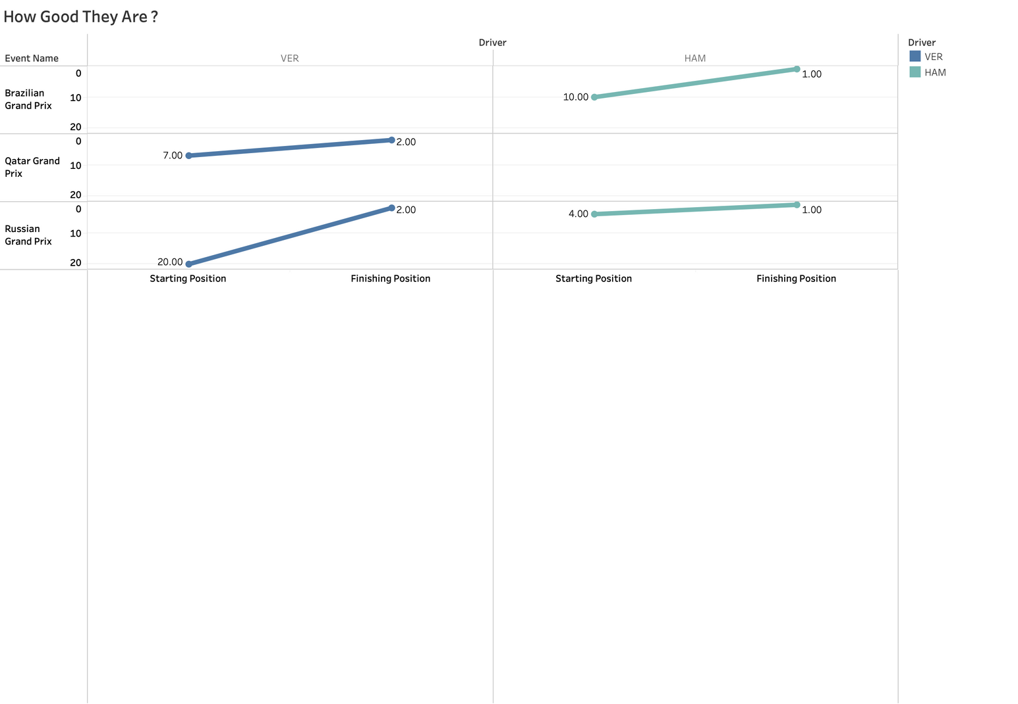
VER VS HAM
Fighting In Each Year
Wherever They Start They Do Good

Slide 18
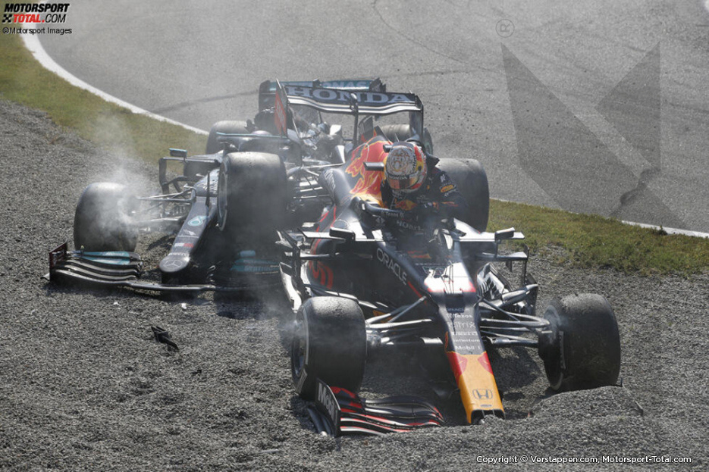
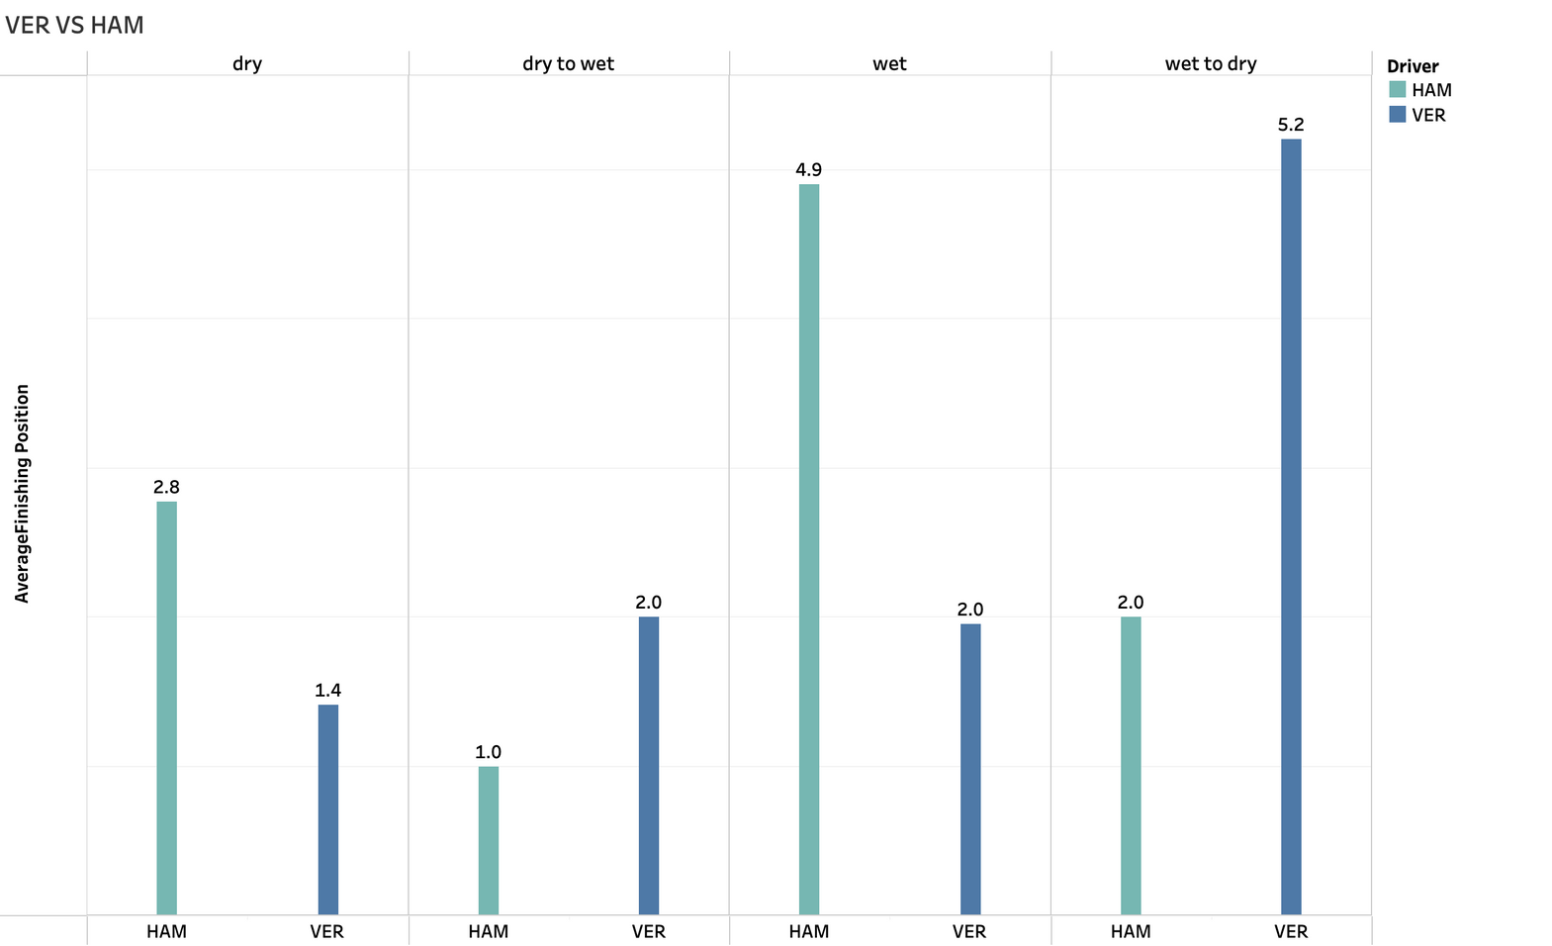
Finishing Position On Average
comparing the average finishing position for the two championship protagenes in 2021 in the wet and dry conditions

Slide 19
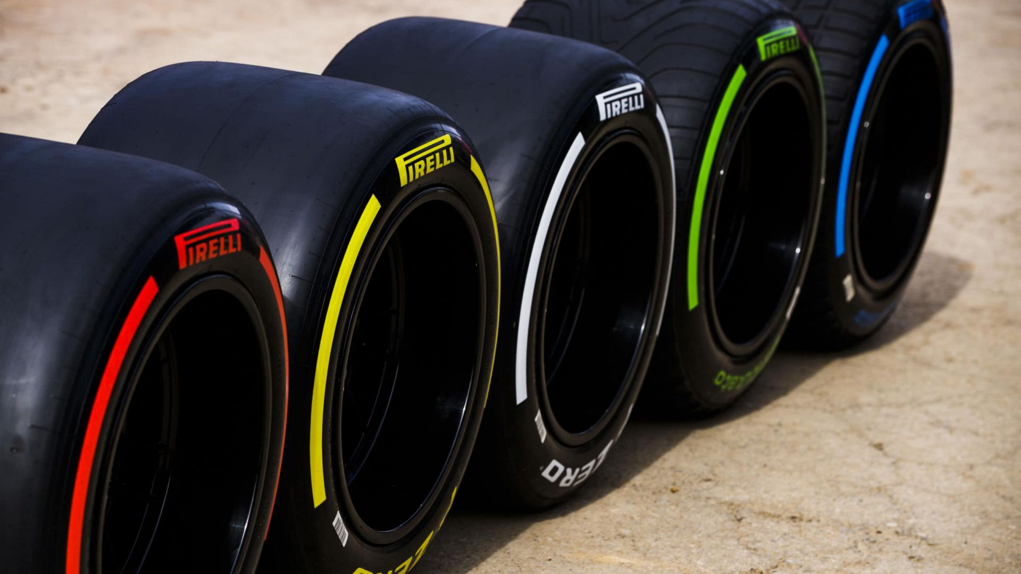
Tires And Strategy

Slide 20
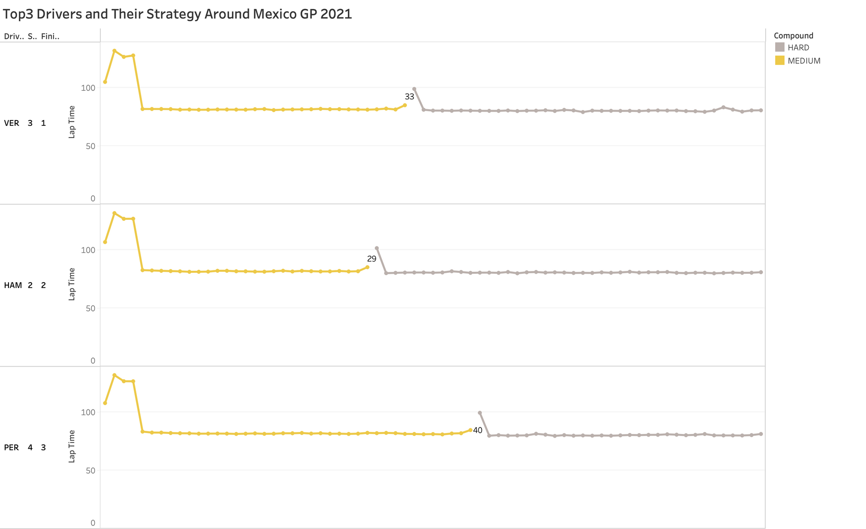
Strategy Effectiveness
Doing The Same Thing Differently
|------||------|
🔄
stint 1
stint 2

Slide 21
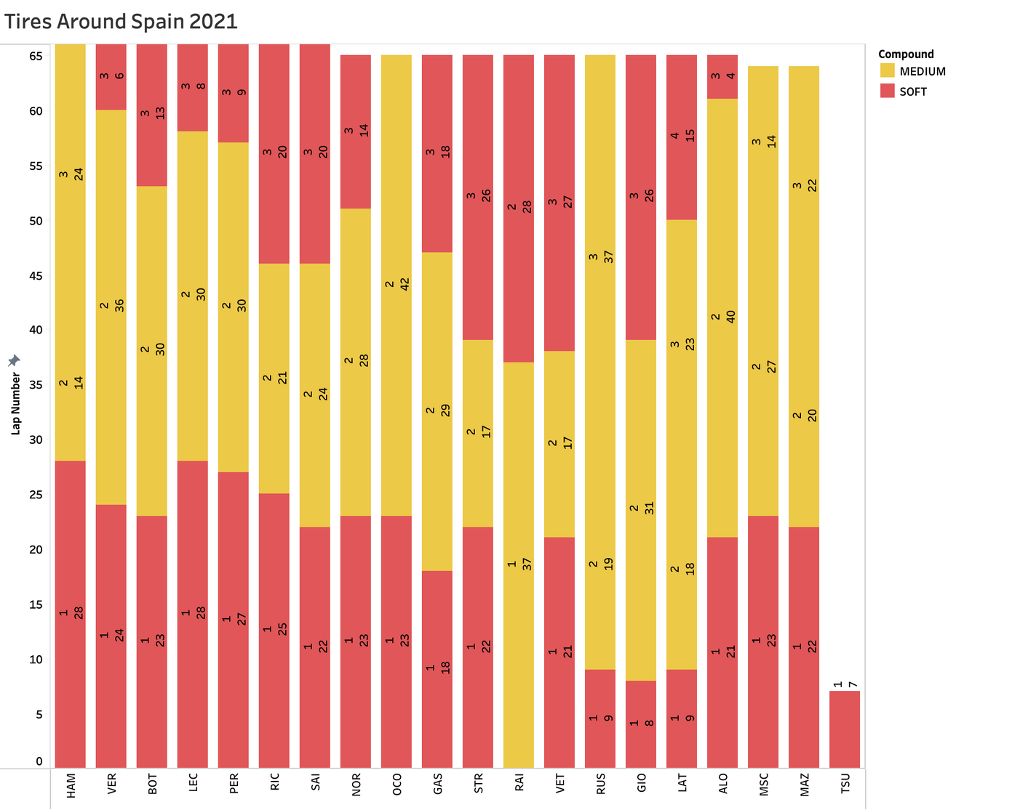
Tires Degradation
(Did Not Finished ) Due To Fuel System Failure
DNF

Slide 22
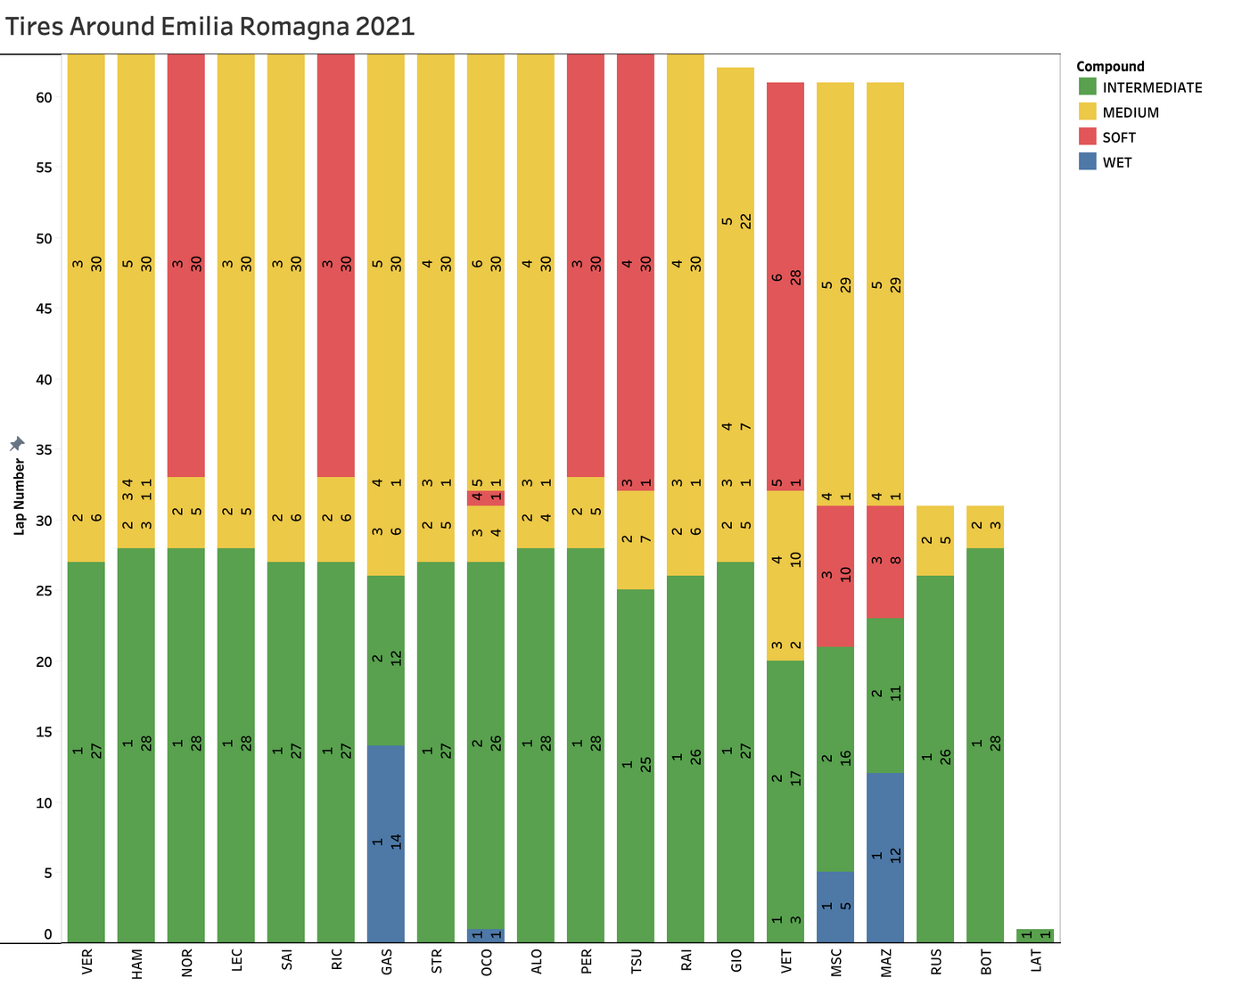
Tires Degradation
DNF
Due To A Crash Between Them In Lap 31
Due To An Incident In Lap 1

Slide 23
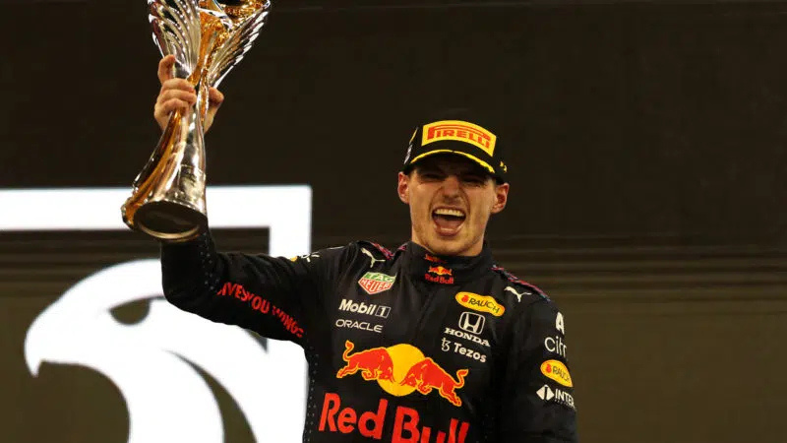
Title Decider

Slide 24
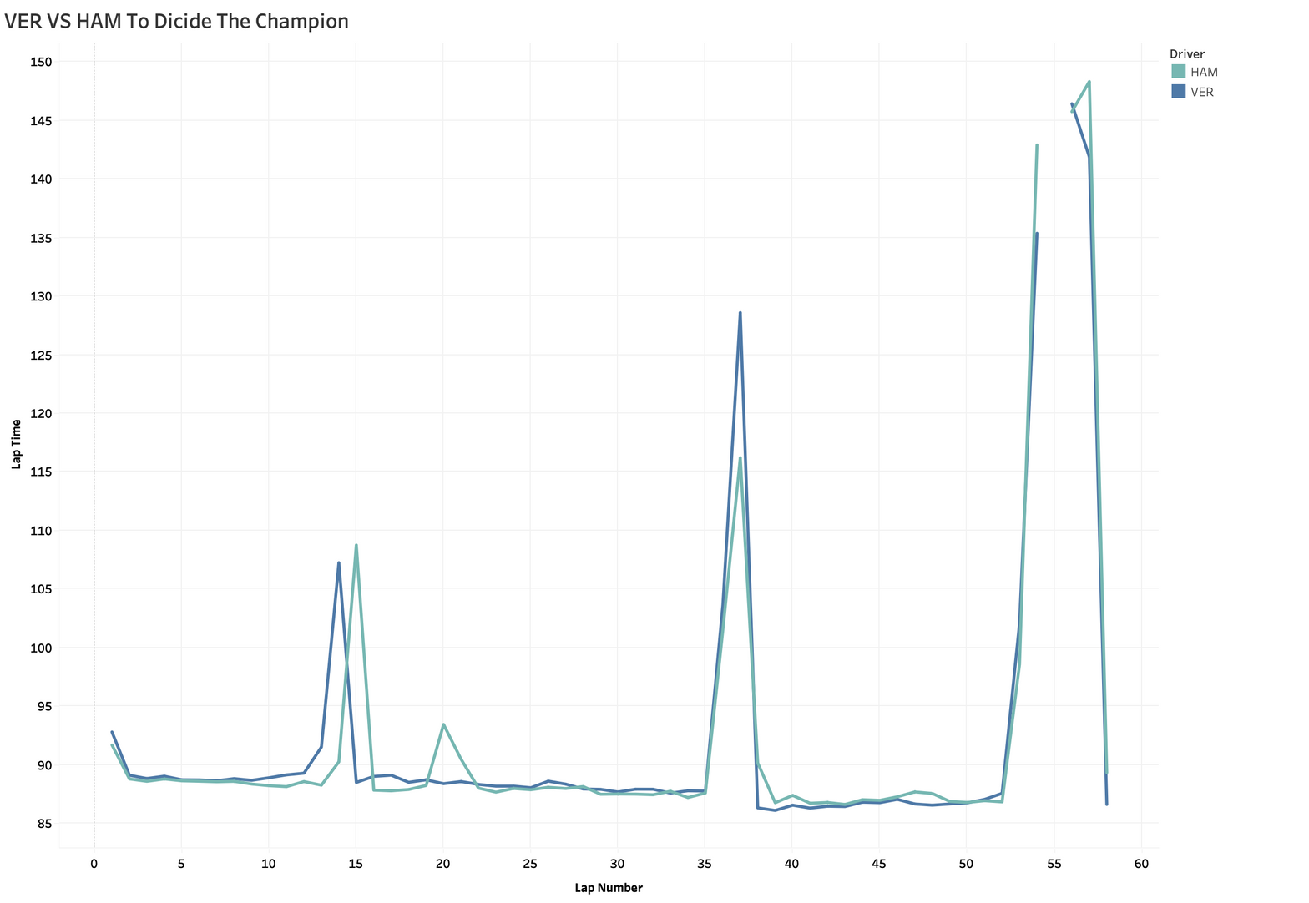
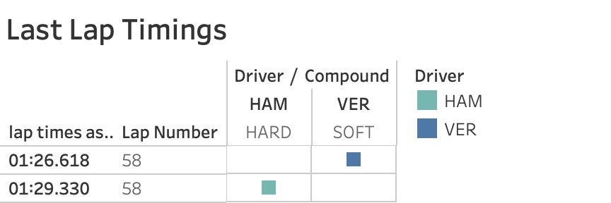
Strategy Difference
Lap 36
GIO Stoped On Track Led To A VSC
HAM Stayed Out
VER Went For His 3rd Stint
For Hards Again
Lap 13
VER Ends Stint 1 With Softs And Started Stint 2 With Hards
Lap 53
Ful SC Due To LAT Crash With The Wall
HAM Stayed Out
VER Went For His 4rd Stint
For Softs

Slide 25
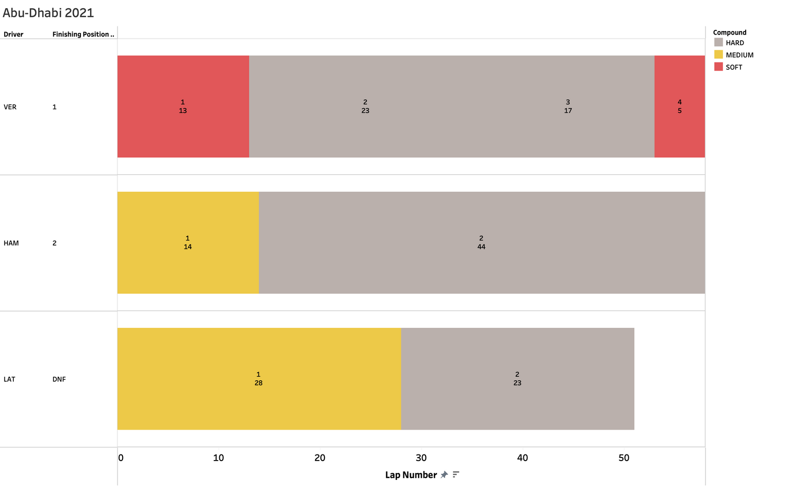

Strategy Difference
by changing the tyre in the last 5 laps VER has won his first championship

Slide 26
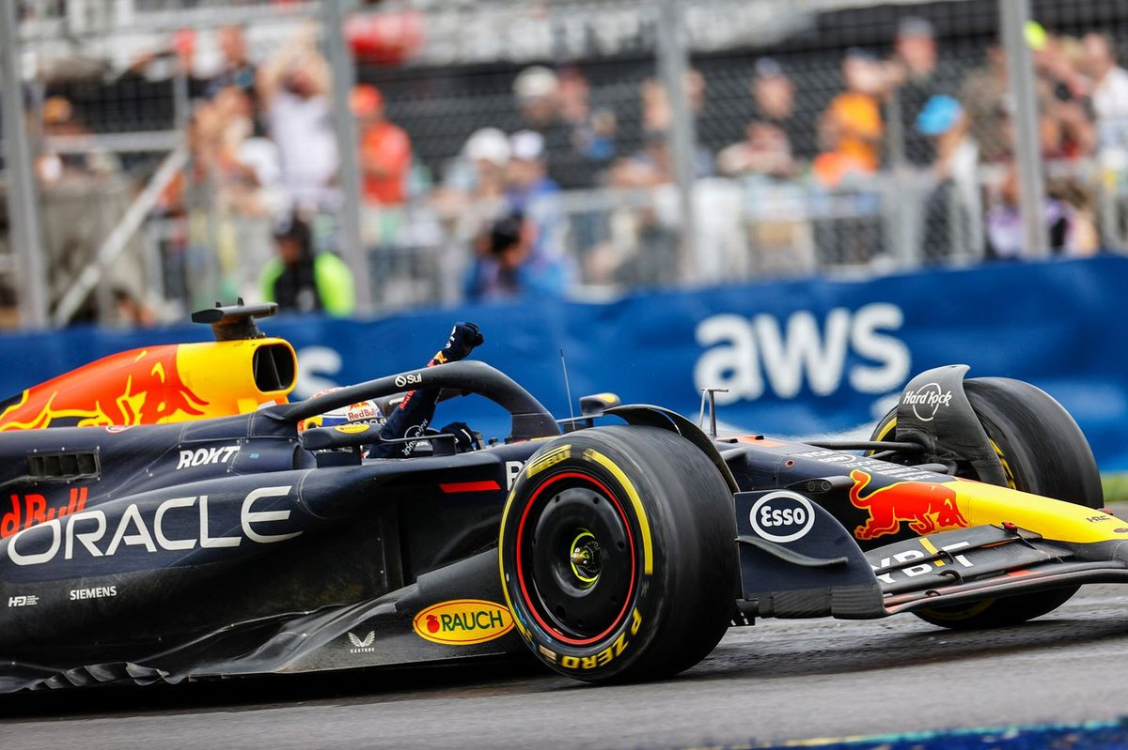
Conclusion
Tires are decisive – strategies can win or lose championships (e.g., Abu Dhabi 2021).
Driver skill matters – a strong driver can push constructors to higher positions.
Weather impacts performance – unpredictable conditions make races more challenging.

Slide 27
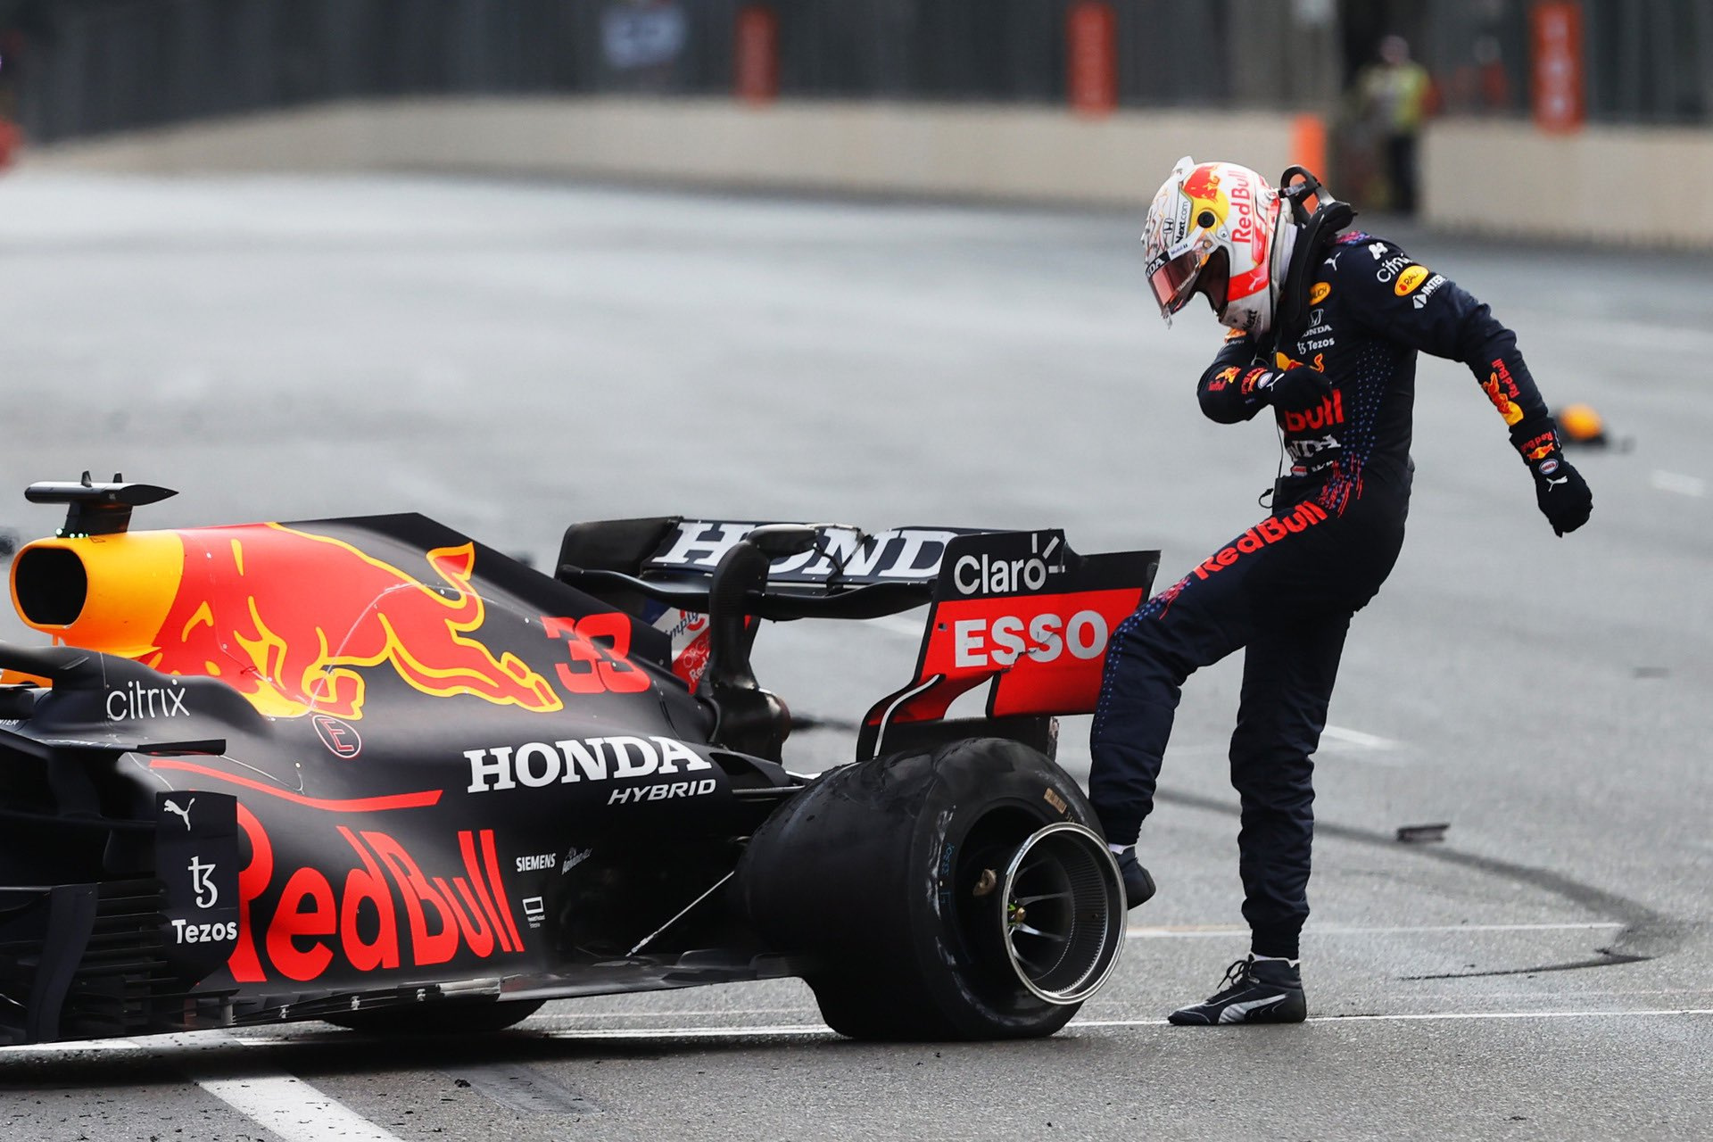
Limitations
Missing qualifying data
Including qualifying would require a separate analysis

Slide 28

Thank You

